Slide 1
Programming 1 - WEEK 1
Introduction
Arithmetic

Slide 2
Introduction
Who is who
Study Time – Schedule
Evaluation
GenAI
Class Rules

Slide 3





Who is who - Lecturers

Slide 4


Who is who - Students

Slide 5
Study time
Class hours
9 weeks
3 sessions / week
2 hours / session
Extra individual study time
4 hours / week = AVERAGE
Exam preparation
IMPORTANT
Make sure to keep up with individual study time, to get most out of class time
Programming skills = practice, not studying
Attendance will be recorded every class

Slide 6
Study time
Core-session
All theory of a specific topic
Weekly test (PE)
Class hours
9 weeks
3 sessions / week
2 hours / session
Skills-session
Focus on programming skills
Algorithms, pseudocode, extra examples
Work-session
Your turn: exercises!
Always a lecturer present to help

Slide 7
Schedule
Week | Topics | Core ( + test ) | Skills | Work
W1 | Arithmetic | Mon 30/9 | Tue 1/10 | Thu 3/10
W2 | Booleans, Conditionals, None | Mon 7/10 | Tue 8/10 | Thu 10/10
W3 | Strings | Mon 14/10 | Tue 15/10 | Thu 17/10
W4 | Loops | Mon 21/10 | Tue 22/10 | Thu 24/10
W5 | Tuples, Lists | Mon 4/11 | Tue 5/11 | Thu 7/11
W6 | Sets, Dictionaries | Thu 14/11 | Mon 18/11 | Tue 19/11
W7 | Objects | Thu 21/11 | Mon 25/11 | Tue 26/11
W8 | Objects, File I/O | Thu 28/11 | Mon 2/12 | Tue 3/12
W9 | Objects, Exam Prep | Thu 5/12 | Mon 9/12 | Tue 10/12
Group | Classroom
1TI/01 | C205
1TI/02 | C206
1TI/03 | C205
1TI/04 | C206
1TI/05 | C206
1TI/06 | C205
1TI/07 | C205
1TI/08 1TIVP/SN | C206

Slide 8

Evaluation
Permanent evaluation
- Every Core session starts with a test
- For a total of 6 points (*)
- Legitimate absence in SVS is taken into account
- 7 best tests → 1 joker
- Guess correction: +1 / -0.5
- Only during class & in class
(*) Retake in august: Permanent evaluation recalculated to 4/20

Slide 9
Evaluation
Exam
- You receive a portfolio with exercises during Christmas Break, to work on
as a preparation for the oral exam in january
- At the exam you receive a solution for 2 random exercises of the portfolio,
to analyse during preparation time. During the oral exam you get insight
questions about the given solutions (no use of laptop).
- For a total of 14 points (*)
(*) Retake in august: Permanent evaluation recalculated to 4/20, 16 points to earn at the exam

Slide 10
GenAI
Permanent evaluation & exam
GenAI is strictly prohibited
Using GenAI is considered a violation and will be reported to the ombuds service
The exam committee will decide on any sanctions
During work sessions / individual study time
Always try to understand and solve errors on your own first
Ask the lecturer for help when needed
Test GenAI suggestions thoroughly and ensure you understand the code

Slide 11
Class Rules
Attendance Recorded every class session at xxh05
Arriving late → door open: you enter quietly
→ door closed: don’t enter (you would interrupt class), door will
be open during break or exercises
Laptops General rule: Close your laptop
Only work on your laptop during a work session or when
specifically mentioned by the lecturer
Tip: pen & paper ☺
Break You leave the classroom, make sure you are back in time

Slide 12

Questions?
Let’s take our first test!

Slide 13


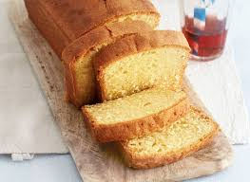
What is programming?
Writing instructions that a computer can understand and execute
→ Step by step → algorithm
Goal is to solve problems, automate tasks or create interactive systems
Different programming languages
→ We will use Python

Slide 14

The bridge riddle

Slide 15

Arithmetic
Functions
Identifiers
Operators
Numbers
Rounding, min/max
Local variables
Assignment

Slide 16
Functions
Remember the example of making a cake?
The different ‘high level’ steps are comparable to functions
take_ingredients()
make_batter()
bake_cake()
Each function consists of detailed instructions
Example make_batter()
Take a bowl
Split the eggs
…

Slide 17
Functions
Let’s start coding with an easier example
I need a function to multiply a given number by 10
multiply_by_ten()
Each function consists of detailed instructions
Example multiply_by_ten()
Take a number
Multiply by 10
Save the result
Return the result

Slide 18
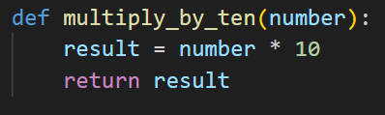

Functions
A function has:
A meaningfull name
A body containing the statements
Can require additional information (input) → parameter (optional)
Can return a result (output)
()
:
indent

Slide 19
Functions
Take a number
Multiply by 10
Save the result
Return the result

Slide 20
Functions
Take a number
Multiply by 10
Save the result
Return the result

Slide 21
Functions
Take a number
Multiply by 10
Save the result
Return the result

Slide 22
Functions
Take a number
Multiply by 10
Save the result
Return the result

Slide 23
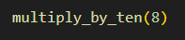
Functions
After defining a function, you can call it by specifying the name, followed by brackets (and a parameter value if needed).
Function Definition
Function call
→ output: 80

Slide 24
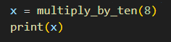
Functions
After calling a function, you might get a value being returned and you need to decide what to do with it.
Function Definition
Function call → 80 is printed to the
terminal

Slide 25

Let’s take a closer look at how this works in real life…

Slide 26
Identifiers
Functions and parameters need names, so you can refer to them. These names are also called identifiers.
RULES
Can be any combination of
letters: upper & lowercase
digits
underscores
First character cannot be a digit
Case sensitive
CONVENTION
Use descriptive names
Identifier should be lowercase
If an identifier consists of multiple words, these words should be separated using underscores (_)

Slide 27
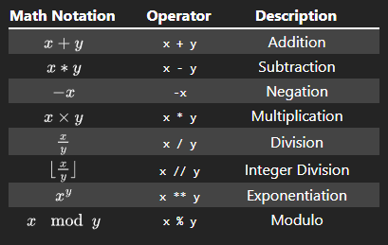
Operators
Python offers the typical mathematical operators
Integer division
a // b : How many times does b fit into a?
Modulo
a % b : What’s the remainder when you divide a by b?

Slide 28
Numbers
How are numbers internally stored?
INTEGER
Can represent arbitrarily large whole numbers
No decimals
Efficient
FLOATING POINT
Also able to represent whole numbers
Support decimal numbers
Less efficient
Note: Use only if required – as they have limitations and will not always return the expect result.

Slide 29
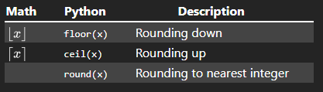
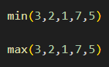
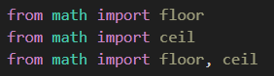
Rounding, min/max
You can use existing functions to
turn a floating point number into
an integer by rounding it:
You can use existing functions to find
out the minimum or maximum:
Note: floor() and ceil() are not available by default.
They need to be imported.

Slide 30
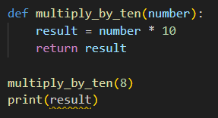
Local variables
→ result and number are local
variables
→ They are not known outside the
function

Slide 31
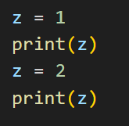
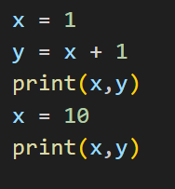
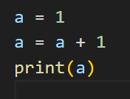
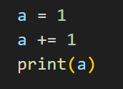
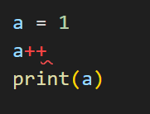
Assignment

Slide 32



Installation & setup
Follow the instructions step by step on Toledo
→ https://toledo.ucll.be/

Slide 33


